Slide 1
Lec 04: Engineering (H) and Rational Decision (D) Making in Taking Ideas (A) to Market
EEE 452: Engineering Economics and Management
M. Rokonuzzaman, PhD
Zaman.rokon.bd@gmail.com
www.the-waves.org
©️Rokonuzzaman
--use is permitted only for the purpose of EEE 452 (sections 1,2, 3, 4 & 10 offered at NSU in Srping 2023;no consumption and distribution is allowed for any other purpose

Slide 2
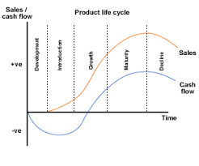
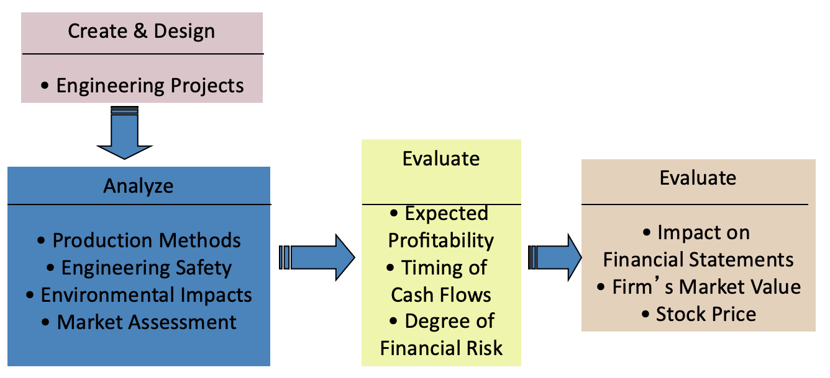
What do Engineers do?
Should engineers manage product life cycle?
“Apply the principles of science and mathematics to develop economical solutions to technical problems”
Engineers work in a variety of fields to analyze, develop and evaluate large-scale, complex systems. This can mean improving and maintaining current systems or creating brand new projects. Engineers will design and draft blueprints, visit systems in the field and manage projects.
  Design products (and services)
  Build and test these products
  Design plants in which those products are made
  Design systems that ensure the quality and
  efficiency of the manufacturing process
  Analyze systems to evaluate their performance
  Develop software to control systems
  Innovate to improve performance of existing systems
Should engineers also contribute to?

Slide 3
Rational Decision Making Necessity:
Engineers are supposed to know science, technology, idea generation, design optimization, fabrication, testing, documentation, and commissioning for offering technology solutions to economic problems. Unlike other branches, engineering is supposed to deal with deterministic relations between variables. Hence, they are supposed to deal with certain characteristics and outcome. As a result, their decisions are highly optimized—based on proven science.
However, engineering is increasingly required to take decisions in an uncertain situation. Often, the reality will be known after long time, even decades. For example, in addition to knowing how to reach optimal design, they are expected to predict the likely maturity of emerging technologies. Based on such predictions, often, investment decisions are made in reinventing products by changing mature technology core.
Invariably, technology possibility exploitation journey begins at loss. The fate of such loss making beginning depends on the progression of the target technology core. In addition to it, there are many factors affecting the business viability of the technology chosen today. The reality keeps unfolding, extending the uncertainty, even, over decades.
Hence, engineering is increasingly facing the challenge of taking rational decision in the midst of uncertainty over prolonged period in nurturing faint technology possibilities into wealth creation reality.
IBM failed to take the advantage of PC due to rational decision making failure. Similarly, Sony succeeded due to rational decision making performance. Rational decision making is at the core in taking advantage of unfolding technology possibilities and also countering threat.

Slide 4
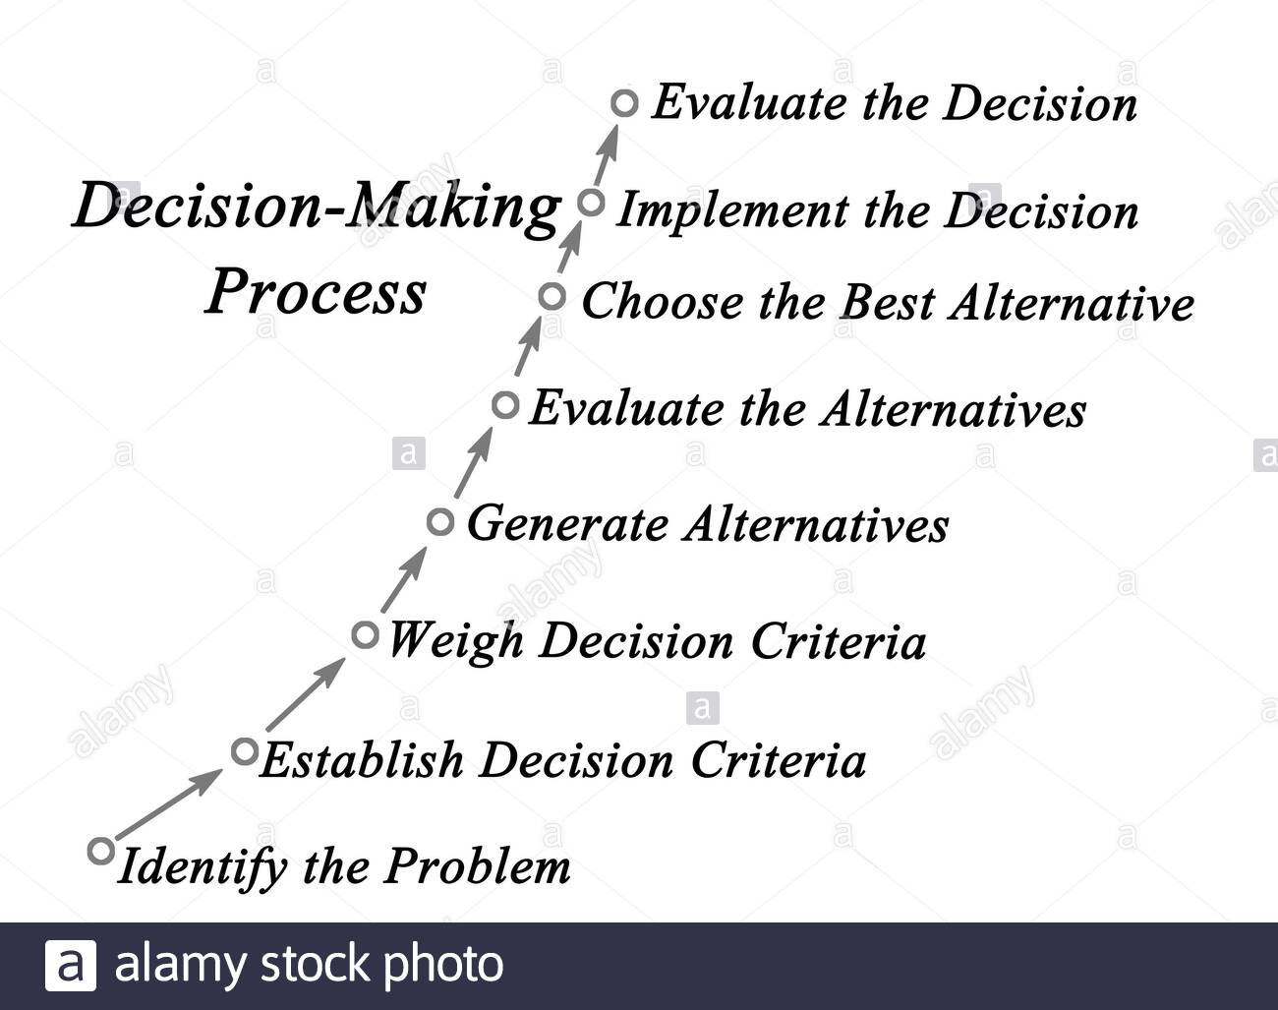
Rational Decision Making
For increasing and sustaining profitability, some of the decision making challenges are i. should we add or remove this feature, ii. should we develop this technology for rolling out certain type of innovations, or iii. should we change the technology core, and so on.
Implementation of each of this decision costs huge some of money; but, the economic implication is uncertain. For example, Honda decided to advance humanoid technology for rolling out robot caregiving innovations. After investing $500 million over almost 30 years, Honda faced consequence of the uncertainty of consumer preferences.
But decision should be made in the midst of uncertainty. Often, it takes decades’ of work to get to know the reality. One of major challenges in decision making to pursue technology possibilities is pervasive uncertainties over prolonged period.
The rational decision making process demands a good understanding about the technology innovation dynamics in creating economic value in the globally connected competitive market. It demands the detection of reoccurring patterns so that reality could be interpreted and unfolding future could be predicted by feeding data into the model. In the absence of it, decision making exercise looks like the act of wild guessing or heroic act.
D provides guidance about what ideas should be produced and how those should be converted into economic value.
Y=F(K, L, H, A, D)
D is the output of rational decision making process.

Slide 5
Rational Decision Making Process for Exploiting Technology Possibilities
Step 0: select and adapt appropriate framework in the form of reoccurring patterns to comprehend and predict wealth creation dynamics out of technology possibilities in a competitive market. This framework is vital to support remaining steps.
Step 1: Identify the problem-- a failure to identify the problem clearly can derail the entire process. It can sometimes require serious thought to find the central issue that must be addressed.
Step 2: Establish Decision Criteria—it needs to determine what is relevant in making the decision. This step will bring the decision maker’s, and any other stakeholder’s, interests, values and preferences into the process.
Step 3: Weigh Decision Criteria--the criteria identified will seldom be equally important, you will need to weigh the criteria to create the correct priority in the decision.
Step 4: Generate Alternatives--once you have identified the issue and gathered relevant information, now it is time to list potential options for how to decide what to do.
Step 5: Evaluate Alternatives--after creating a somewhat full list of possible alternatives, each alternative can be evaluated. Which choice is most desirable and why? Are all of the options equally feasible, or are some unrealistic or impossible? Now is the time to identify both the merits and the challenges involved in each of the possible solutions.
Step 6: Select the Best Alternative--after a careful evaluation of alternatives, you must choose a solution. You should clearly state your decision so as to avoid confusion or uncertainty.
Data, Logic, Theory, and Facts--Rational decision making is defined not only by adherence to a careful process, but also by a logical, data-driven manner of following the steps of that process. The process can be time-consuming and costly. It is generally not worthwhile on everyday decisions. It is more useful for big decisions with many criteria that affect many people.
Theory plays a vital role in rational decision making to pursue an unclear mission.

Slide 6
Pervasive Uncertainties
Technology possibilities are fraught with pervasive uncertainties. Some of them belong to:
  Technology progression
  Consumer preferences
  Competition responses
  Public policy and regulation
  Ecosystem formation
  Externalities and Infrastructure
  Spillover effects
Continued performance improvement is at the core of creating economic value out of technology possibilities. Despite amenability to progression, there has been wide variation in rate of performance improvement over R&D effort. There are also danger of reaching saturation point before reaching the target of causing creative destruction. Lack of clarity of consumer preferences is another source of uncertainty. Responses of the competition is quite unpredictable as well.
Increasingly, public policies, ecosystem, externalities, infrastructure and spill over effects are becoming important for assessing likely economic value creation possibilities. However, there are also adding uncertainties. For example, the take off of Electric vehicles demands positive role from all these areas. But, they are beyond the reach of a single firm. Hence, such dependence adds to growing pervasive uncertainties in the mission of turning technology possibilities into profitable return. Furthermore, time horizon has been extending--from years to decades.

Slide 7
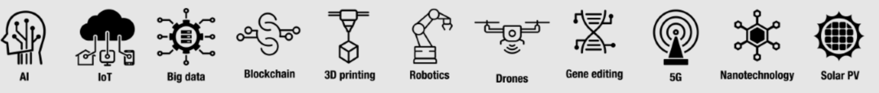
Technology Uncertainty:
Primitive Emergence of Technology Possibilities
Invariably, every powerful technology emerges in primitive form. Each of them looked very inferior to alternative existing technology. For example, even automobile emerged as inferior to horse wagons. Similarly, mobile phone, transistor, electronic image sensor, and many other emerged with a faint potential. Invariably, this primitive emergence either leads to overlooking the potential or creating hype.
The challenge is to detect the latent potential and take measures. If mistake is made, not only, we miss the opportunity to profit from emerging opportunity, but also run the risk of suffering from the destructive effect.
For example, as PC emerged in primitive form, IBM gave away the role of developing operating system and producing processor to little Microsoft and Intel respectively. Subsequently, IBM not only lost the growing business opportunity to them, but also it suffered from major destructive effect. Due to that reason, once highly successful, companies like RCA, Kodak, and DEC suffered from massive loss.
On the other hand, response to emerging technologies also runs the risk of suffering from massive loss—as not all technologies are equally amenable to progression and produce profitable revenue. For example, plasma display lost the battle to LCD. Similarly, Fuel Cells has been struggling for decades. Upon investing more than $80 billion in R&D, autonomous vehicle innovation is yet to roll out.
There have been pervasive uncertainties in amenability of progression, time, effort, and comparative performance.

Slide 8

Loss making beginning and uncertainty in reaching profitability:
Virtually, all technology possibilities begin at loss. This is one of the reasons is for the need of further R&D work before innovations are rolled out. However, at the beginning, perceived value will be far lower than the cost of delivery. Hence, rolling out will increase the negative cash flow, and it has a natural tendency to keep increasing.
To turn the loss making revenue towards positive, technology possibility should be improved further. But the amenability to improvement in improving the quality and reducing the cost is not predictable. Hence, how long it will take to reach profit is not certain.
For example, Uber started with a big promise to replace conventional taxies with robot taxis—for offering better quality alternative at less cost. But despite showing early promise, the robo taxi is now stuck. As a result, it’s total loss has been growing since its roll out in 2011. Defying conventional expectation, loss of Uber continues to scale up in step with revenue growth rather than decline.
On the other hand, Tesla’s loss has been shrinking, indicating profitable future (without subsidy). This is due to the fact that Tesla’s battery suppliers are benefiting from the progression of technology in offering increasingly higher quality battery at less price.
Hence, technology uncertainty is a critical issue affecting the growth of revenue, along with the reduction of loss, for reaching profitable future. It does not occur naturally. It requires progress in an untraversed territory. Hence, the journey of reaching profit is fraught with pervasive uncertainty.
Not always reaches to profit.
natural tendency of increasing loss
Technology possibility
Performance
Effort over Time

Slide 9
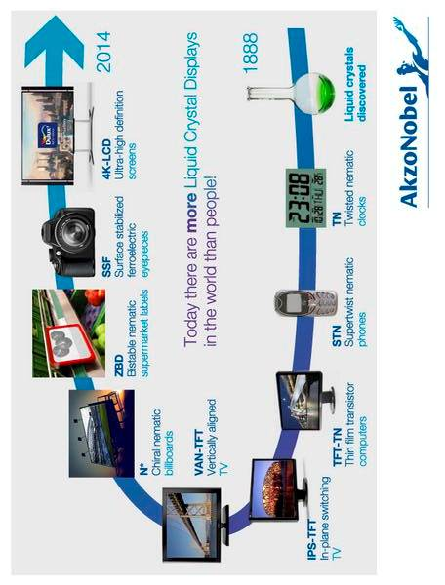
Unclear, Unpredictable and Unfolding Spillover Effects:
Potential return on technology possibility is not limited to its use to one product. Possibility could be exploited through multiple channels. Besides, multidimensional implications or spillover effect on the overall economic and social aspect are also very difficult to anticipate at the beginning. By the way, spillover effect could be both negative and positive.
The difficulty of assessment of spillover effect makes it quite hard to justify investment, and also mobilize public supports.
For example, the exploitation of possibility of lithium-ion battery started with the purpose of offering high-density battery for portable digital camera. At the beginning, it’s positive implication on climate change was never anticipated. Instead, there was concern about its negative implication on environment for abetting e-waste.
Similarly, after more than 100 years journey, the possibility of LCD was not much clear in the 1980s. In those days, LCD was looked upon as a technology of producing seven segment display for calculators or watches. But over ten years in the 1990s, it grew to as a quality display for mobile phone. Its accelerated progression made it superior to plasma technology for large sized flat display panel. In addition to size, the technology showed high amenability to increase resolution and reduce cost.

Slide 10
Increasingly Costly Experimentation:
One of the popular approaches of pursuing unfolding technology possibilities is: let’s give a try. But unlike the past, cost of some experimentations is enormously high. In most of the cases, race is about to take over the mature wave with the emerging one.
Due to the growing gap between emerging possibility and the alternative to be overcome, the cost of experimentation is getting very high. Even, if the emerging wave shy away slightly from incumbent one, the whole investment of fueling the volley turns into sunk cost. Furthermore, for some great ideas, there has been need for making investment in infrastructure to demonstrate the potential.
Let’s assume that A is the incumbent wave of gasoline engine based automobile, that took 130 years to reach at its current position. In 2007, ‘better place’ got into the mission of exploiting lithium-ion possibility to take over it by creating the wave C. But it succeeded to create wave B. Consequentially, it unfolded by liquidating $850 million investment for just $450,000.
Similarly, upon spending $500 million over more than 30 years in R&D in pursuing robotic care giving wave to take over human nurses, Honda discontinued further R&D in ASIMO. There are many more examples. Furthermore, cost of experimentation has been growing. For example, instead of investing millions, Edison figured out that his Phonograph did not have profitable business opportunity, just after spending 30 hours of machine work in building the usable prototype.
Hence, such costly experimentation has been accentuating pervasive uncertainties.
C
A
B
Performance
Time

Slide 11
Uncertainty in Expected Profitability:
As we know, every journey of exploiting technology possibility begins the journey at loss. Due to the continued R&D, loss turns into profit. As shown in the figure, there are two major zones in the financial performance: i. losing making L and ii. profit making P.
It’s quite difficult to predict the size of L. It depends on a number of factors, including amenability of progression and R&D productivity. It also depends on the the gap to overcome to take over the incumbent wave. It also depends on competing technologies.
On the other hand, profit making area P depends on multiple factors. Some of them are: 1. success in creating willingness to pay, ii. cost of delivery, iii. price setting capability, iv. sustaining innovation waves, v. number of value extraction windows, vi. profitability duration, and vii. emergence of the next wave.
By the way, there have been many variations of this pattern. For example, upon investing in R&D over 12 years, Sony turned its loss making journey of exploiting electronic image sensor technology possibility into profit. It started extracting value of image sensor by rolling out portable video and still digital cameras. But within 20 years, it encountered destructive effect from smartphone cameras—resulting in endling up profit into loss. Upon changing business model from making digital camera to supplying sensors to smartphone makers, Sony succeeded to turn the loss again into profit.
Typical loss and profitability patterns of technology possibilities
Profit
P
L
Time

Slide 12
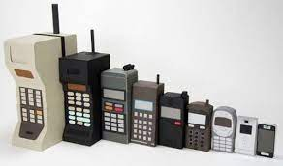
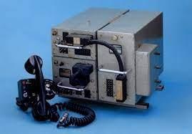
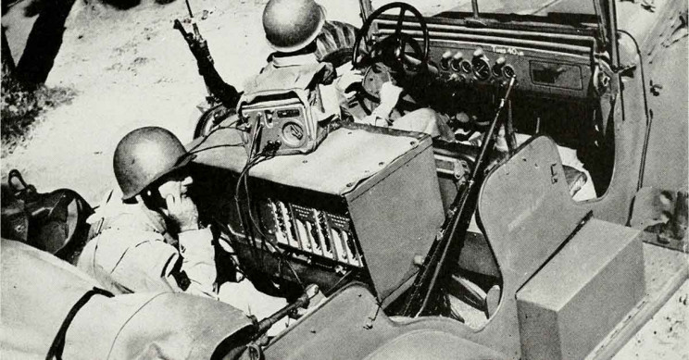
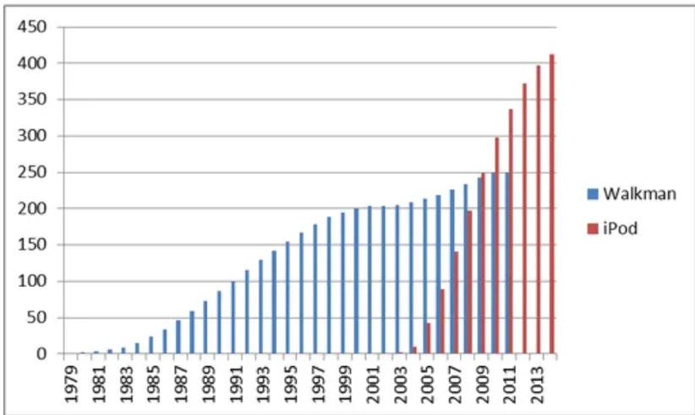
Uncertain Product Life Cycle:
There have been multiple attributes of product life cycle. And they are unpredictable. The first one is about how should it grow in serving different customer segments? What should be the sequence of serving them?
For example, the consumer segment is the largest market for the cellular phone. But during its emergence in the 1940s, consumers were not interested in the primitive emergence. Hence, innovators targeted the military market for the infant product. Subsequently, they targeted taxi service for offering radio communication. Along with further growth, innovators started focusing on additional markets, starting from car phone to phone for all.
But it does not mean that all products around tarted technology possibility equally grow through different market segments, from military to consumer. For example, RADAR technology possibility is still confined within military and aerospace markets. Recent initiative of autonomous vehicle is attempting to exploit it for consumer market.
Furthermore, every product is amenable to growth through the cumulative effect of incremental ideas, leading to facing the ultimate fate of disintegration. Managing the uncertainty of self-destruction and recreation is a big challenge in product life cycle. This uncertainty causes decision making dilemma, leading to failure of even high performing firms. Managing the transition between successive phases of a product life has been a grave challenge.
Figure 6: Superimposition of two waves—fall of Sony Walkman and Rise of Apple iPod

Slide 13
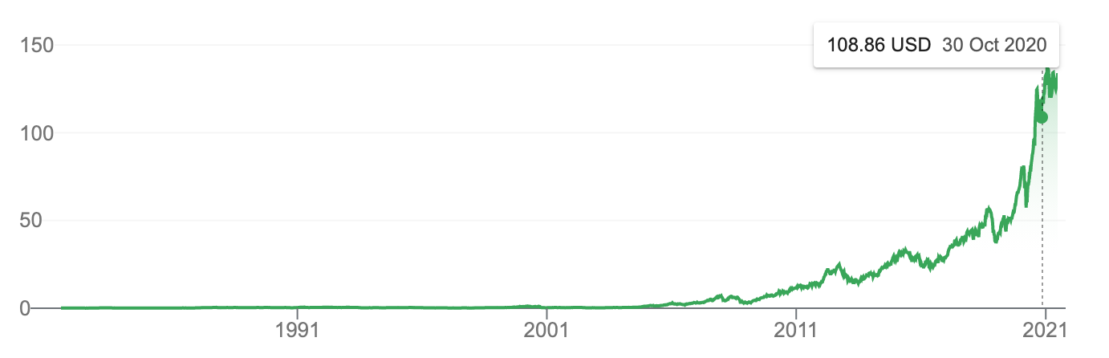
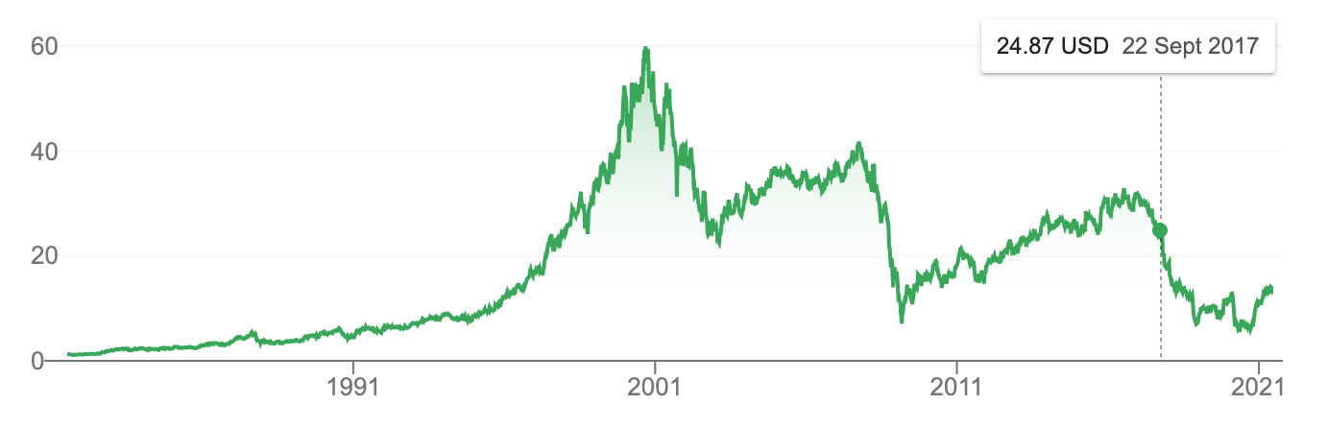
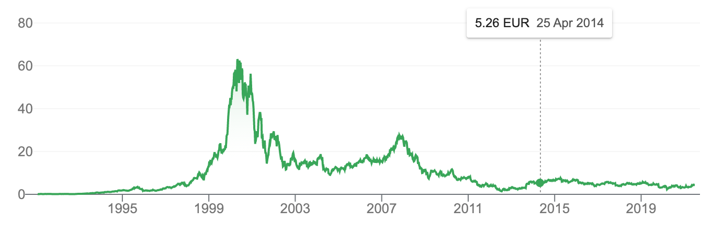
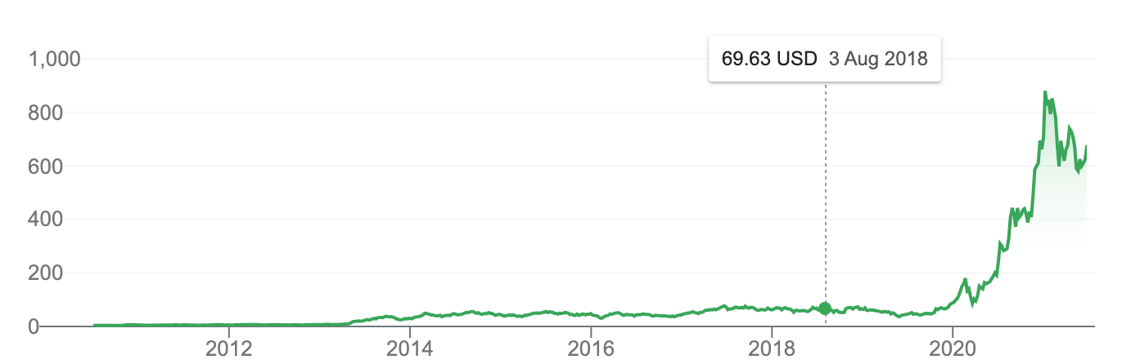
Unpredictable Stock Price and Firms’ Market Value: linked with technology possibilities
Here are historical stock price of four very well known companies: Apple, GE, Nokia and Tesla. A we notice Apple share price appreciated from $0.37 in 2001 to $136 in 2021--370 times overt just 20 years. But GE’s share price fell from $58 in 2000 to $6.50 in 2020—almost 9 times. Similarly, Nokia suffered share price fall from EUR 63 to EUR 2.24 in 2011. On the other hand, Tesla’s share price rose from $5.58 in 2012 to $880 in 2021.
What are the underlying factors in such big swings in the share price or market value of these companies. Despite the inherent volatility nature in the stock market, there appears to be the effect of decisions in pursuing technology possibilities. For example, Apple’s share prize spiked due to Apple success in pursuing the decision of iPod and iPhone. On the other hand, due to failure in responding to wind energy and sharply reducing footprint in fossil fuel, GE suffered from massive fall in share price. Similarly, Nokia experienced shar gain due to its strong response to customer preferences to mobile phone handset as a fashion item. Subsequently, it suffered from massive fall due to the emergence of smartphones (like Blackberry, Palm) leading to iPhone. On the other hand, rally in Tesla’s stock is due to rapid growth in performance of lithium-ion battery.
For a number of reason, stock price matters. First of all, often, management compensation is linked with stock price appreciation. Besides, employees are often given company’s stock as bonus, as opposed to giving cash. Furthermore, stock price directly affects the value of ownership. Therefore, technology possibility should be given due consideration, as it effects stock.
Apple
GE
Nokia
Tesla

Slide 14
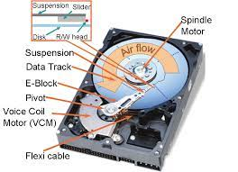
Uncertain Growth Path
Although, we perceive technology life cycle as A—S-Curve, the reality experiences many variations. Some of the variations are like B, C and D.
For example, A appears to be the life cycle of hard disk. But, in reality, its life cycle took the shape of B. Data storage density in hard disk depends on multiple factors. One of the predominant ones is the dimension of read-write head. Upon reaching apparent limit in the 1970s, it started growing again due to the maturity and adoption of photolithography in producing smaller heads.
On the other hand, Fuel Cell is showing the life cycle of C—very slow growth. The life cycle D represents the growth behavior of thermoelectric technology.
Such variations in life cycle creates significant uncertainty in technology progression and the exploitation of innovation possibilities. Hence, we need to carefully monitor, model, perform root cause analysis and predict likely unfolding future. This is a very critical management practice for responding to unfolding possibilities.
A
B
Typical growth path
Performance
C
D
Effort over Time

Slide 15
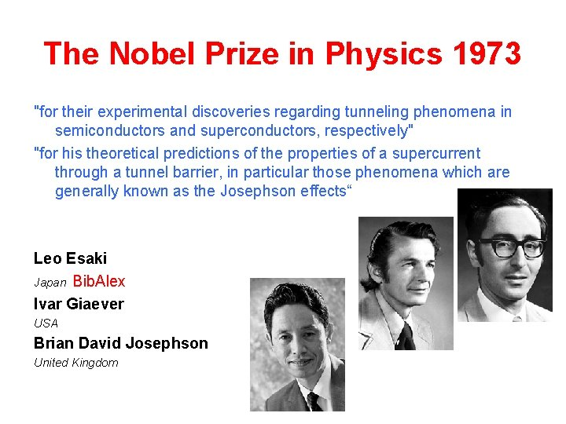
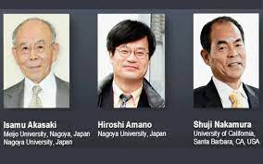

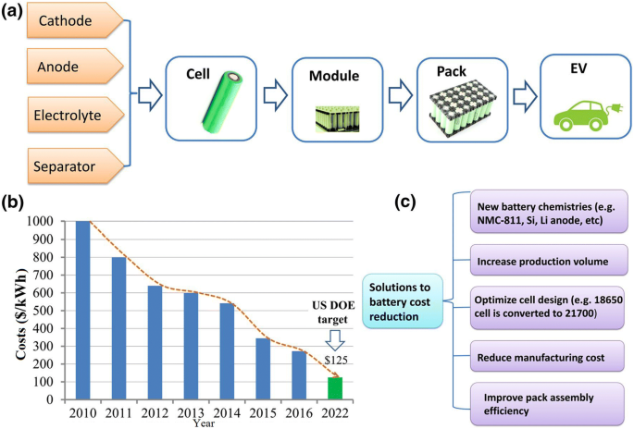
Demanding Scientific Discoveries:
Sony’s uprising from a repairing shop in war ravaged Nihonbashi area of Tokyo to global innovation leader demanded significant advancement in science—on making Transistor increasingly better and cheaper. This journey led to winning Nobel prize by one of its R&D team member in 1973—for advancing a Nobel prize winning invention. This scientific journey underpinned Sony’s success in turning their primitive Radio, TV and many others as innovation successes.
Despite having a long history of scientific investigation since the demonstration of Electroluminescence phenomenon in 1907, Japanese Nichia encountered an apparent insurmountable barrier exploiting the innovation possibility of LED lighting. Hence, it had to sponsor basic scientific research, resulting in scientific discovery for needed technology advancement and winning Nobel prize by one of its R&D team members.
Another notable examples has been Lithium-ion battery. The exploitation of progressively unfolding innovation potentials of this wonderful energy storage technology has been demanding continued scientific discovery—leading to awarding Nobel prize.
Yes, pursuing technology possibility, whether as product or process innovation, demands entrepreneurship, start-up, and engineering practice for optimisation, they are not sufficient enough. In fact, there has been growing demand for scientific investigation for unlocking latent potential.

Slide 16

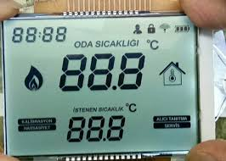
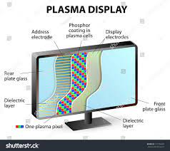

Competing Multiple Technologies:
Competing multiple technologies to take over a mature incumbent one creates also uncertainty. Despite having potential, they do not keep growing at the same space. They keep varying in multiple factors, starting from quality, manufacturability, durability, and recyclability. This variation increases decision making complexity. The persuasion of them simultaneously increases cost. But pursuing just one of them increases risk.
For example, three have been competing display technologies. Although LCD display has root in scientific discovery in 1888, the cathode ray tube (CRT), invented in 1897, rapidly grew as a preferred option of display—primarily for television and scientific instruments.
Subsequently, in 1936, Kálmán Tihanyi, a Hungarian engineer, described a proposed flat-panel plasma display system in an academic paper.
However, due to further scope of incremental advancement and low cost of production, CRT kept dominating display innovation still early 1980s.
The middle of 1980s started witnessing race between the growth of two competing technologies, plasma and LCD, to take over the performance of CRT.
Although Plasma showed early potential of being a better technology for large flat panel display, but the dawn of the 21st century started observing accelerated growth of LCD. Eventually, LCD has become winner—with the end of long journey of CRT and Plasma.
Hence, management of technology possibilities demands dealing with uncertainties posed by competing technologies.
LCD
CRT
Performance
Plasma
1888
1936
1992
Time

Slide 17
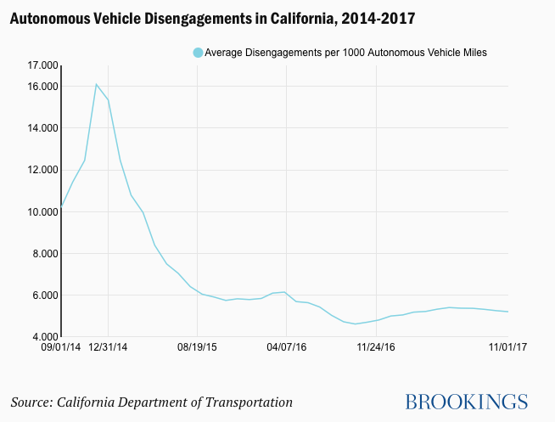
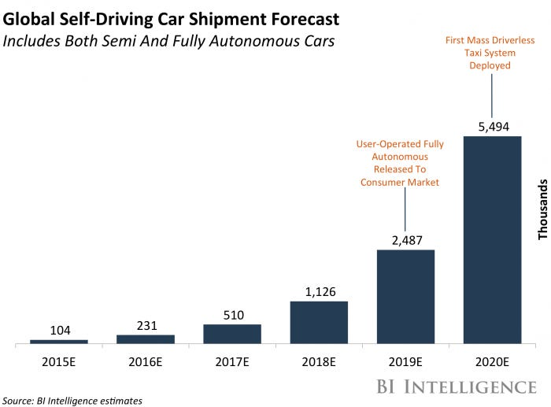
Misleading Early Progress: Extrapolation fails to predict
Some technologies show rapid early progress. Particularly, in artificial intelligence, performance improvement rate at the early stage is extremely high. In many situations, this rate does not sustain for sufficient period. Alarmingly, performance improvement trend saturates before crossing the threshold. Such reality runs the risk of failure to roll out innovation and recover the investment made in R&D and also infrastructure development. It also causes significant stress in the job market.
For example, autonomous driving technology shows rapid progress in terms of high rate of fall of disengagement frequency. Based on extrapolation of such data, predictions started unfolding. However, well all know by this time how wrong those predictions have been. But such misleading nature of progression challenges many management decisions and also likely future on R&D investment. For example, future return of more than $80 billion investment in R&D is now highly uncertain. If the progress keeps oscillating over the next decade, patents produced during the first decade of the 21st century will run out of life.
The prediction failure in autonomous vehicle has caused stress in the job market. Particularly, in the USA, autonomous vehicle prediction discouraged youths to pursue professional driving job, leading to shortage of truck drivers.
Prediction based on extrapolation early progress
Progress in reality
Threshold to cross
Performance
Prediction based on extrapolation early progress
Progress in reality
Time

Slide 18
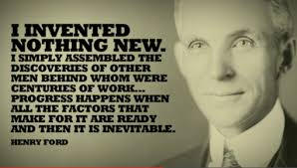
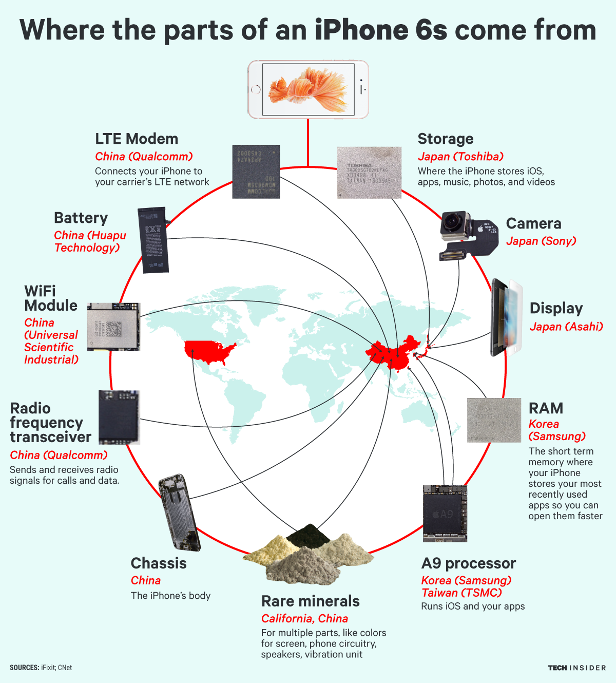
Technology Supply Chain and Ecosytem:
Often, the journey of pursuing technology possibilities demands gathering, fine tunning, and assembling component technologies in a purposeful way within a framework or architecture. Starting from Henry Ford to Steve Jobs, every magical performer had to do it.
In certain cases, as opposed to gathering the technology set within a same company, the reality demands partnering with diverse technology providers from all over the world. Such reality demands forming an integrated global technology supply chain to pursue a particularly possibility.
On the one hand, it is not feasible for a single innovator to have the best in house capacity for all the components. On the other hand, in house sourcing also limit the economies of scale and also scope advantage. Hence, forming a global ecosystem for technology supply is a critical requirement as well as challenges.
For example, Tesla has been sourcing the critical technology building block for its EV from Japan and China. Apple has been sourcing components from more than 200 suppliers—distributed all across the world.

Slide 19
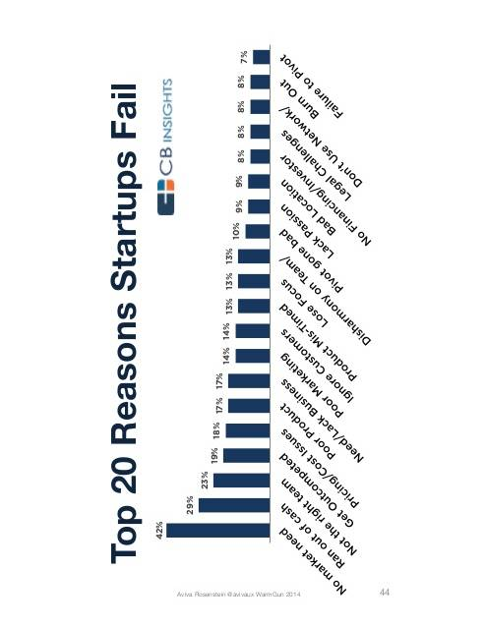
Consumer Preferences
Misleading Consumer’s Early Feedback
Uncertainty in consumer preference is a major source of uncertainty in pursuing technology possibilities. Repeatedly, consumer preference uncertainty has been found to the top most reasons of startup failure.
But how to reduce it? Should we talk to target customers? Should we use a number of tools like survey, key informant interview, and focused group discussions to get to know what customers want?
Although those tools produce useful inputs, they run the risk of being incomplete, and even misleading. As Steve Jobs said, “ People don't know what they want until you show it to them. That's why I never rely on market research. Our task is to read things that are not yet on the page.” He goes further, some people say give the customers what they want, but that's not my approach. Our job is to figure out what they're going to want before they do. I think Henry Ford once said, 'If I'd ask customers what they wanted, they would've told me a faster horse.’
But how to get to know about consumer preference without asking them what they would like. Should we go for brainstorming and experimenting with a long list of ideas until we find the match? It’s a highly expensive approach. Some of the areas which we should focus on are empathy, silent observation, and quick prototyping using paper, wood, clay, and so on.

Slide 20
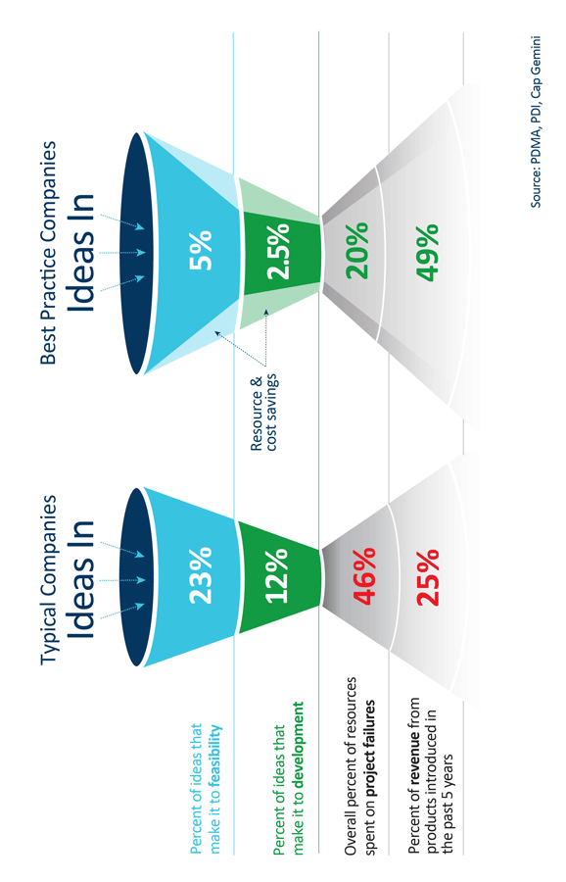
Significant Investment Need to Verify Consumer Preferences
“Although 84% of executives agree that innovation is important to growth strategy, only 6% are satisfied with innovation performance.” McKinsley Global Innovation Survey
“In 2018, 65% of companies decide to wait to perfect and test the innovation before launch, in order to make sure the customer is completely satisfied from the start” GE Global Innovation Barometer 2018
One of the common approaches to reduce consumer preferences related uncertainties is to show the real product, let customers experience, and get the feedback. But that is very expensive option.
Upon suffering a loss of RS 1000 crore, TATA came to know that consumers did not like less costly compact cars—Nano. By the way, Airbus also came to know that customers preferred shorter point to point flight over comfort and onboard amenities like shower in Airbus A380 while flying through hub airports. But Airbus suffered from a loss of $25 billion (money spent for the development of A380) to get to know it.
Some of the areas which we should focus on are empathy, silent observation, and quick prototyping using paper, wood, clay, and so on. More importantly, we should look into underlying pattern of innovation dynamics, and its linkage with the getting jobs done.

Slide 21
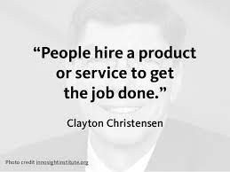
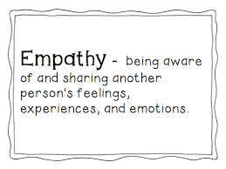
Getting Jobs Done and Empathy for Reading Customers Minds
“Jobs-to-be-done theory tells us that the more jobs a product can help a customer get done, the more valuable that product is as a product platform in that space. The swiss army knife, for example, helps customers get dozens of jobs done, and the smartphone helps customers get thousands of jobs done.”
Here are a few pointers of getting job done theory to get to know consumers mind: (i) People buy products and services to get a “job” done, (ii) Jobs are functional, with emotional and social components, (iii) A Job-to-be-Done is stable over time, (iv) A Job-to-be-Done is solution agnostic— independent of any solution or technology, (iv) Success comes from making the “job”, rather than the product or the customer, the unit of analysis, (v) A deep understanding of the customer’s “job” makes marketing more effective and innovation far more predictable, (vi) People want products and services that will help them get a job done better and/or more cheaply, (vii) People seek out products and services that enable them to get the entire job done on a single platform, and (viii) Innovation becomes predictable when “needs” are defined as the metrics customers use to measure success when getting the job done.
Empathy is the capacity to understand or feel what another person is experiencing from within their frame of reference, that is, the capacity to place oneself in another's position. This is very useful to feel latent pains in getting jobs done, and to figure out innovation to address them.

Slide 22
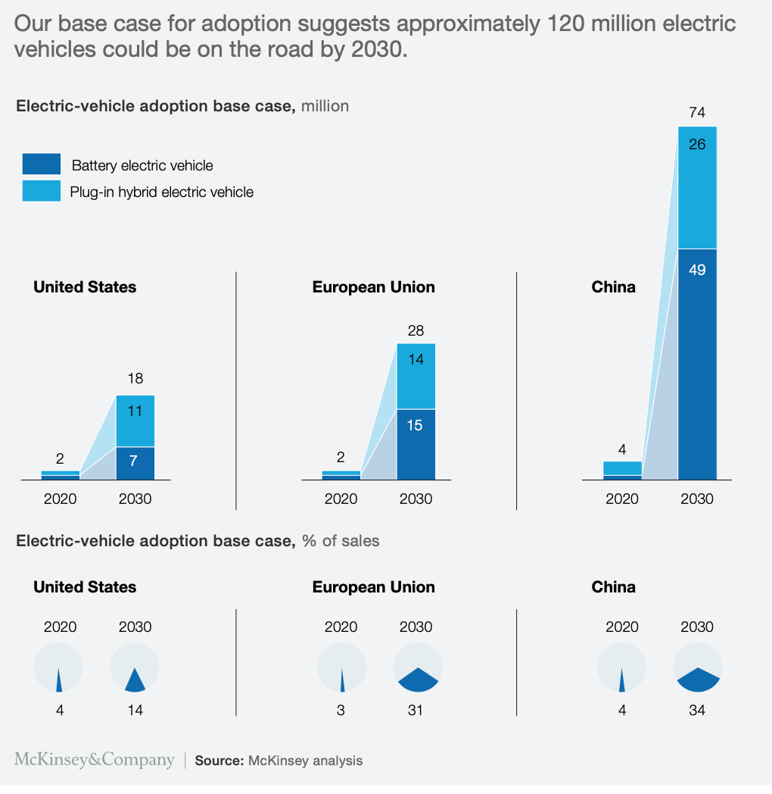
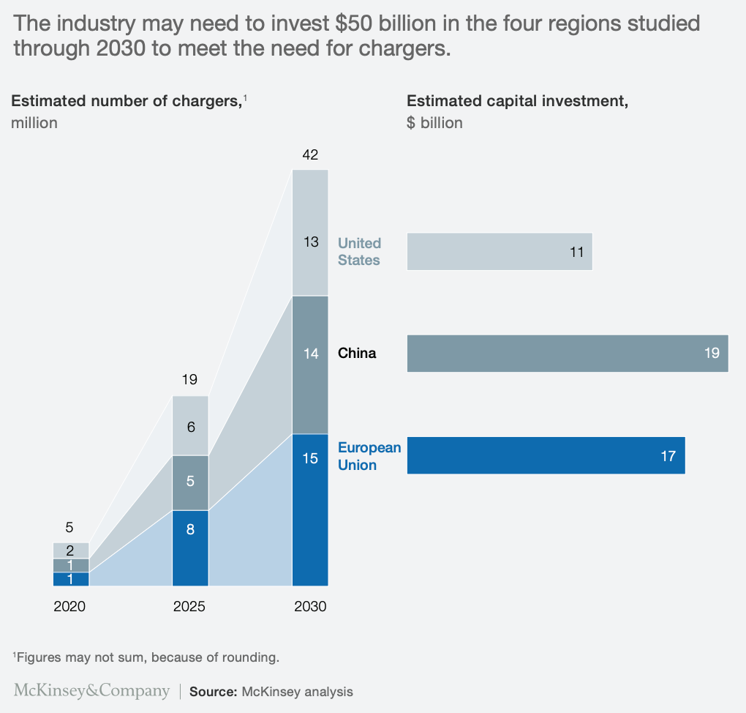
Infrastructure & Compatibility
Major Ideas Demand Infrastructure Uplifting
Economic, social, and environmental implications of some of the technology possibilities such electric vehicle, mobile phones, high-speed trains, or airplanes are extremely high. But to diffuse them, we need purpose built infrastructure.
For example, access to efficient charging could become a roadblock to electric-vehicle uptake. While users welcome new and innovative mobility options, this current paradigm shift presents a challenge for authorities that plan, organize, and operate infrastructure services. In particular, integrating new mobility services into existing infrastructure systems can generate problems of acceptance, co-operability, and compatibility. Limited range and battery capacity of battery electric vehicles make them dependent on charging infrastructure, which in turn hinders their acceptance.
In any country, establishing a demand-oriented charging infrastructure is of crucial importance. However, numerous questions remain unanswered regarding the quantity, type, and location of electric vehicle charging stations. In addition setting up charging stations, electric power production, transmission, and distribution should also upgraded to feed energy to those charging stations too.
Similar, infrastructure development issues are to be addressed to leverage 5G, hydrogen, and maglev.

Slide 23
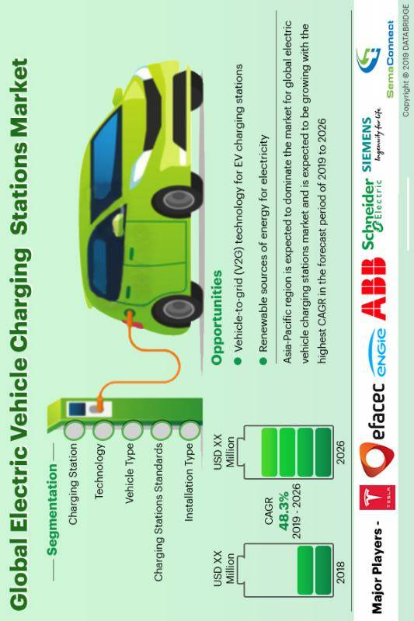
Public-Private Synchronized Response:
Invariably, the roll out of new infrastructure faces market failure. It faces an economic situation defined by an inefficient distribution of goods and services in the free market. Due to market failure, the individual incentives for rational behavior do not lead to rational outcomes in building infrastructure to benefit from unfolding innovation diffusion.
For example in case of infrastructure building for electric vehicle rolling out, analysis suggests three sets of barriers preventing the market alone from achieving a level of investment in chargers that is optimal for society: (i) Market failures – network externalities, (ii) Policy – uncertainty, and (iii) Regulatory – coordination and cost recovery.
Network externality refers to the interdependency between the market for EVs and investment in charging infrastructure. Low EV take-up renders some chargers unprofitable and/or makes potential developers hesitant to invest. At the same time, the paucity of charge points influences the decision whether to buy an EV. This is a typical situation of market failure.
Policy uncertainty is also an issue. For example, incentives and other measures to facilitate the diffusion of EVs. Market failures, policy uncertainty and regulatory barriers have the potential to keep the expansion of public charge point infrastructure below its socially optimal level.
Hence, private sector alone cannot deal with in optimum roll out of infrastructure to support the diffusion of some high-value innovation. Hence, it demands synchronized responses.

Slide 24
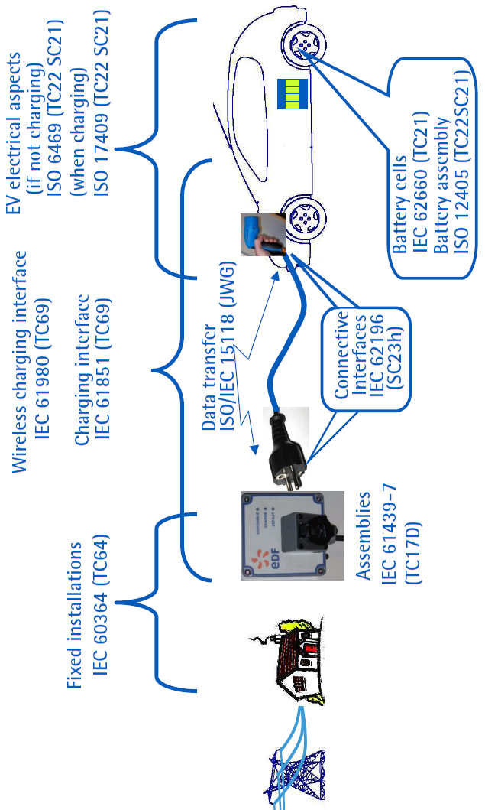
Standardization for Compatibility:
Due to positive network effect, consumption benefits increase with the growth of customer base. For creating positive network externality effect, we need to focus on standardization for compatibility. For example, all electric vehicle producers adopt the same standards for charging, a single charging station could be used to charge vehicles produced by multiple firms. As a result, utilization factor and access to charge station will increase. Therefore, economic benefit from technology possibilities should look into standardization issue for maximizing positive network externality effect.
However, often firms attempt to develop dominance out of proprietary standards—limiting positive externality effect. Hence, there is a roll of policy makers and regulators. However, in failing to be compatible with dominant standards, innovations also get deprived from the externality effect.
For example, for “hardware/software” system, the consumption benefits of the hardware good are increasing in the variety of compatible software. However, high positive network effect creates lock-in effect in favour of old technology.

Slide 25
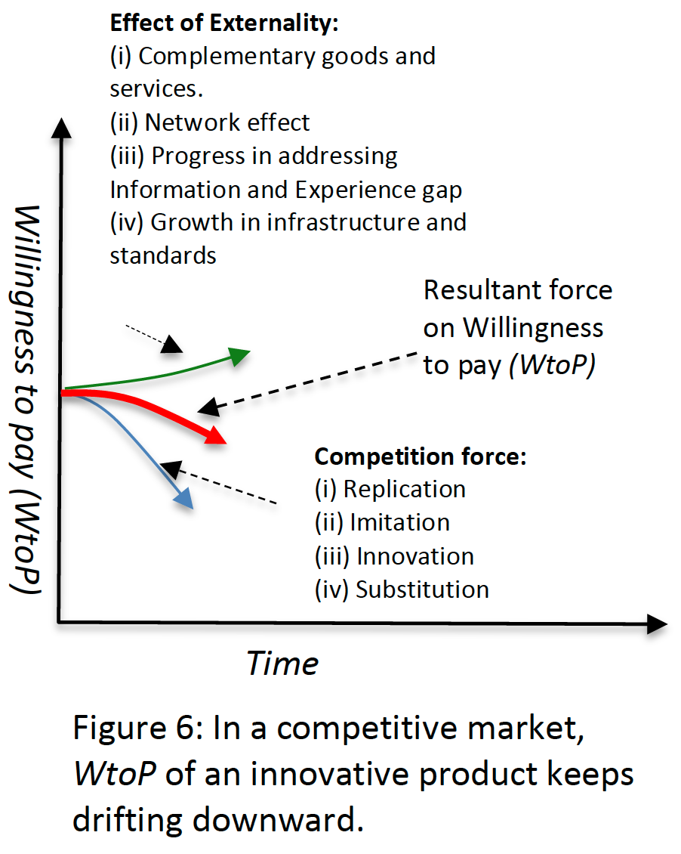
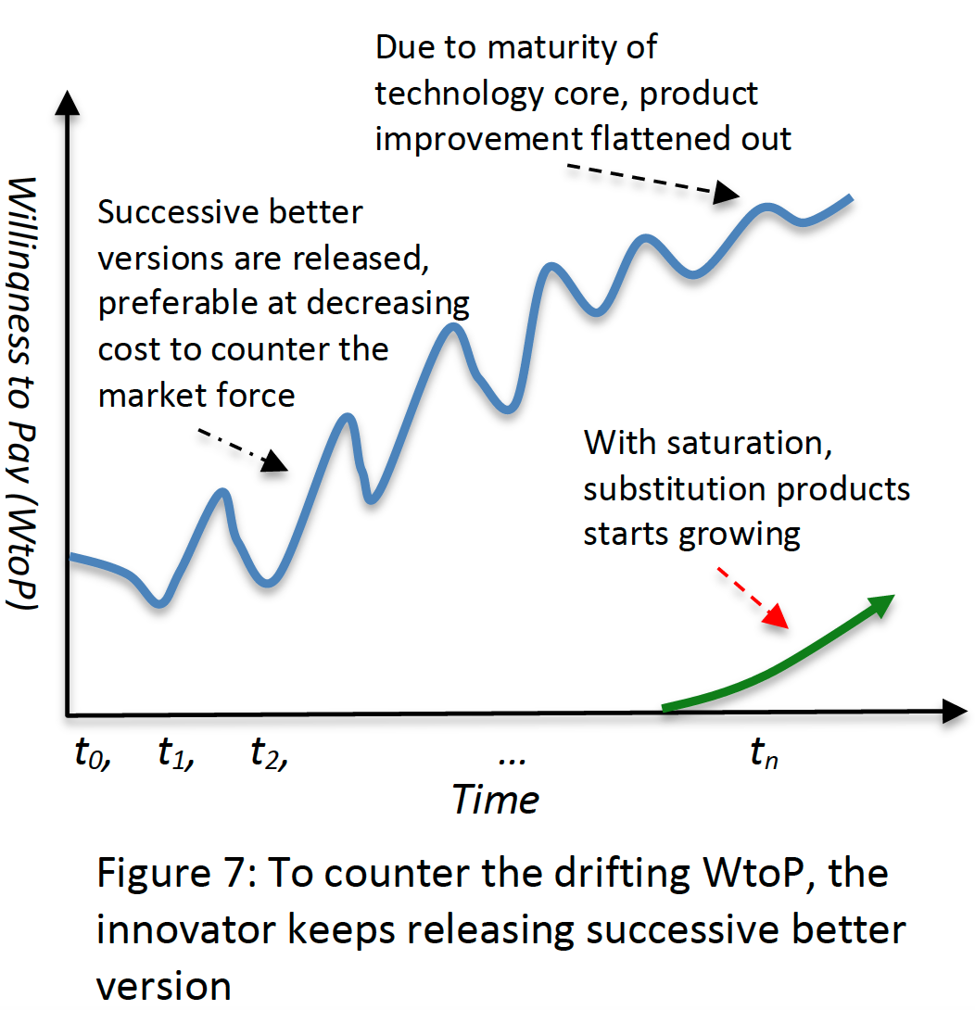
Unpredictable Response from Competition:
Possibility of profitability encourages competition responses, such as (i) replication, (ii) imitation, (iii) innovation, and (iv) substitution. On the other hand, technology possibilities also benefit from (i) complementary goods and services, (ii) network externality effect, (iii) reduction of information and experience gap, and (iv) growth in infrastructure, compatibility and standardization.
To address them one of the common approaches is to fend off competition through intellectual property laws. However, it has limited effect. There has been growing litigation cost and time in pursuing this approach. Another approach is the speed of innovation leading to release of successive better versions, making previous versions less appealing. As a result, followers do not get much time to catchup. This approach also keeps increasing the willingness to pay, leading to market expansion, and revenue growth.
Invariably, the effective means has been to keep releasing successive better versions, preferably at less cost, to sustain the innovation in the market. Hence, innovators need to focus in gathering intelligence and developing idea (patent) portfolio—often, in partnership with technology suppliers.
Furthermore, there has been reinvention threat. Hence, there is also need for gathering early signals, and developing technology inventory and organization capability for dive into self-destruction for recreation at the right moment.

Slide 26
Policy and Risk Capital Uncertainty:
In many journeys of exploiting technology possibilities, it’s not feasible for a single or a group of firms to pursue a long uncertain path. There have been need for consistent policy supports from the government. Some of the policy supports pertain to i. R&D grants and tax credit, ii. creating market for initial primitive emergence, (iii) even offering performance centric subsidies, and (iv) addressing market failure.
Uncertainty related to need and availability to risk capital is also a major issue. By the way, policymakers also face dilemma in adopting favorable policy options. For example, although Indian Government is in supportive to adopt EVs, but diffusion of EVs runs the risk of causing massive jobless in the automobile sector of India—as EVs require less than 50% labor to make than the amount needed by gasoline vehicles. Similar policy dilemma is being faced by the autonomous vehicle innovation in India.
To address such uncertainties and policy dilemma, there should be holistic monitoring, predicting, strategy formulating and implementing exercises. For example, to leverage EV possibilities, China has come up with well designed partnership between public and private sectors.

